Slide 1





ESWASA
MSME CERTIFICATION
#ImprovingTheWorldWeLiveIn

Slide 2

About Us
Vision
The outstanding service provider in quality standards for competitiveness.
Eswatini Standards Authority is the National Standards Body (NSB) of Eswatini
A Government Parastatal under the Ministry of Commerce, Industry and Trade (MCIT)
Established through the Standards & Quality Act (10) of 2003, reviewed in 2023
Started operations in 2007
Mission
We provide internationally recognized quality standards and conformity assessment services to improve business performance and promote trade.
#ImprovingTheWorldWeLiveIn

Slide 3
Our Core Values
Professionalism
We conduct our business affairs reliably, competently and we take accountability for our actions
Responsiveness
We do it right on time and react in a positive and desired manner to our market, customers and stakeholder expectations
People Centricity
We place people first, mutually beneficial relationships are of essence to our performance
Transparency
We are committed standardisers who conduct our business honestly and in openness
Innovation
We embrace and employ new ideas and improved ways in our business dealing
#ImprovingTheWorldWeLiveIn

Slide 4


ESWASA Accreditation
ESWASA is a member of the following international organizations:
Eswatini Standards Authority – Management Systems Certification Services is accredited by the Southern African Development Community Accreditation Service (SADCAS).
Scopes: Quality Management Systems to ISO/IEC 17021-1:2015 and ISO/IEC 17021-3:2017 (Certification to ISO 9001:2015), IAF Codes 3, 12, 13 and 38
#ImprovingTheWorldWeLiveIn

Slide 5
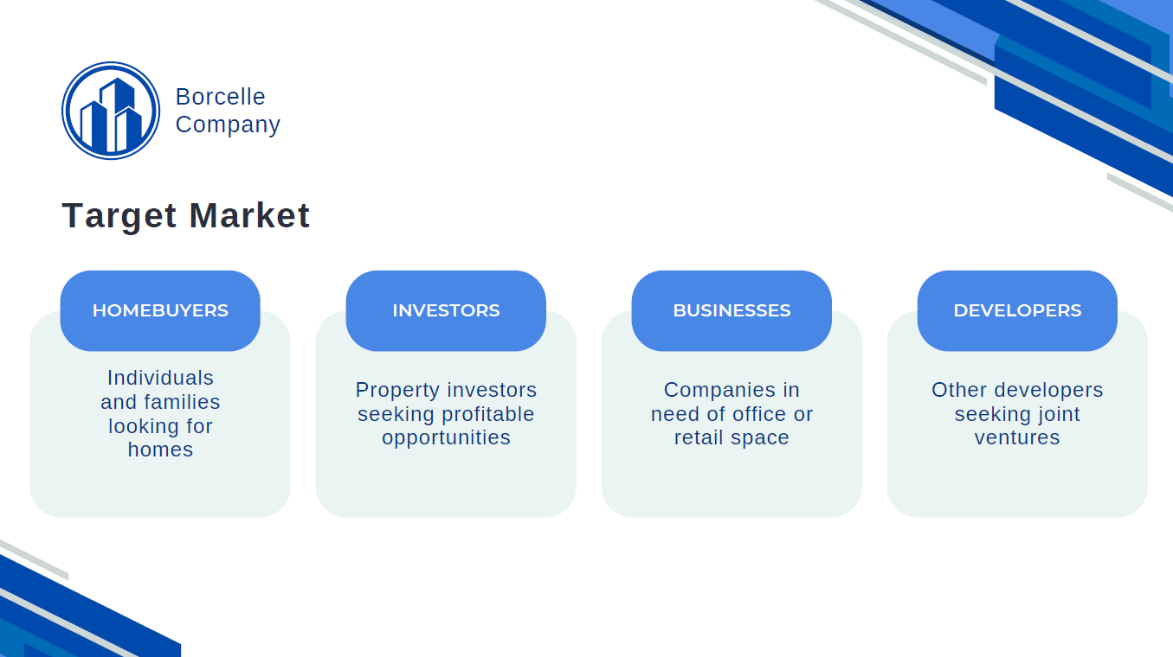








Our Services
STANDARDS SALES
STANDARDS DEVELOPMENT
CERTIFICATION:
MANAGEMENT SYSTEMS
PRODUCT CERTIFICATION
STANDARDS-BASED TRAINING
PRODUCT TESTING
WTO ENQUIRY POINT
SCALES & METROLOGY SERVICES
INFORMATION DISSEMINATION
.
#ImprovingTheWorldWeLiveIn

Slide 6
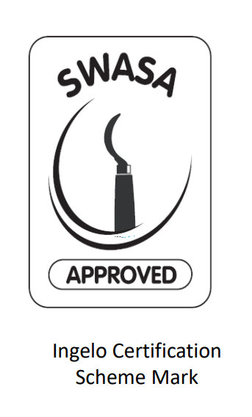

Ingelo Certification Scheme
Scheme for local producers
Launched by Ministry of Commerce Industry and Trade
To assist MSMEs products to meet market quality and safety requirements
To assist cottage producers to achieve certification for systems and products
#ImprovingTheWorldWeLiveIn

Slide 7
Are you a local producer looking to enhance the quality and marketability of your products?
Eswatini Standards Authority (ESWASA) invites Micro, Small & Medium Enterprises (MSMEs) to apply for participation in the Ingelo Certification Scheme – a program developed to support local businesses in achieving product and system certification.
What is the Ingelo Certification Scheme?
The Ingelo Certification Scheme is a scheme for local producers, an initiative launched by the Ministry of Commerce, Industry and Trade:
To support cottage producers in achieving certification for both their systems and products.
To assist producers of products and services in meeting market requirements on quality and safety based on standards requirements.
Benefits of participation:
Improved product quality and safety
Increased access to local and regional markets (e.g access to trade in AfCFTA)
Recognition through the ESWASA Approved mark
Technical support during the certification process
Who Can Apply?
Emaswati
Local MSMEs, involved in the production of any products or offering services
Local MSME producers who are willing to increase production to meet export quota requirements by local and regional markets, through compliance with certification requirements
How to Apply:
Visit: www.swasa.co.sz and download the Ingelo application form.
Completed application forms must be sent to sgama@swasa.co.sz or hand delivered to;
Eswatini Standards Authority - ESWASA
Plot 247, Marbel Construction,
King Mswati III Avenue, Matsapha Industrial Site
#ImprovingTheWorldWeLiveIn

Slide 8
Benefits of the Ingelo Certification Scheme
Improved product quality and safety
Increased access to local markets and readiness of regional markets
Recognition through the ESWASA-approved Mark
Technical support during the certification process
Visit www.swasa.co.sz download form and send completed form to sgama@swasa.co.sz or hand deliver to ESWASA offices
#ImprovingTheWorldWeLiveIn

Slide 9

Benefits of Certification
Market Access & Growth
Many markets and industries mandate certifications as a condition for entry.
Having recognised certifications reduces trade barriers and opens global opportunities.
Certified products and systems help SMEs qualify corporate supply chains.
Customer Trust & Brand Value
Certifications provide independent validation, signalling reliability and safety to customers.
They strengthen brand reputation and can differentiate SMEs from uncertified competitors.
Trust built through certifications often translates into customer loyalty and premium pricing power.
Risk Management & Compliance
Certifications help SMEs minimise legal and regulatory risks.
They serve as documented proof of compliance in case of disputes, audits, or liability claims.
They embed continuous improvement systems that keep SMEs competitive and resilient.
#ImprovingTheWorldWeLiveIn

Slide 10

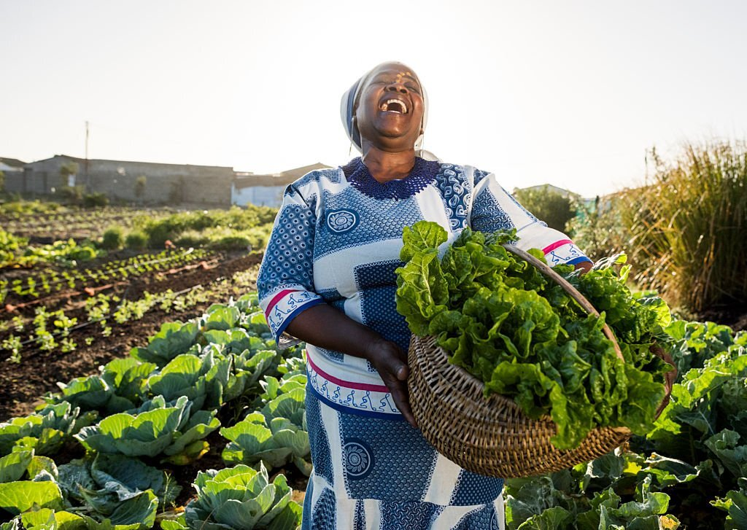
Benefits of Certification
Financing & Investment Appeal
Investors and lenders increasingly assess intangibles when evaluating SMEs.
Certifications add credibility to business operations, boosting investor confidence.
They can enhance company valuation during funding rounds or M&A activity.
Building Long-Term Competitive Advantage
Unlike machinery or stock, certifications don’t depreciate overnight—they compound business credibility over time.
When integrated into IP and brand strategy, certifications become part of the SME’s unique intangible asset portfolio.
#ImprovingTheWorldWeLiveIn

Slide 11
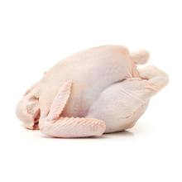
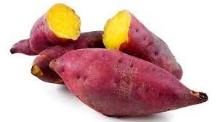

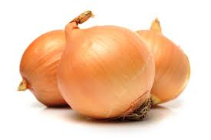


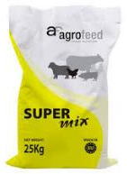
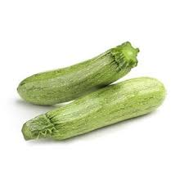
STANDARDS AVAILABLE IN ESWASA
SZNS 025: Poultry processing- Hygiene requirements
SZNS 058: Sweet potato- Grading requirements
SZNS 049: Maize grains- Spécification
SZNS 037: 2Organic fertilizer- Specification
SZNS 060: Banana- Grading Requirements
SZNS BOS 43: Onion – Grading requirements
SZNS KS 052: Fresh Couragettes/ Baby morrow- Specification and grading
SZNS 031:cattle feeds- specification

Slide 12
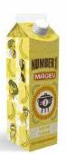
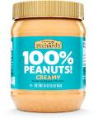
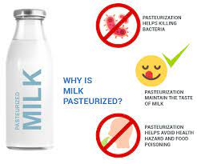
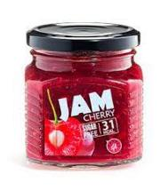
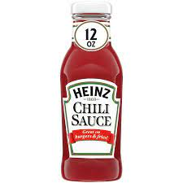
STANDARDS AVAILABLE IN ESWASA
SZNS SANS 1199: Production of Mageu
SZNS 035: Peanut butter Specification
SZNS SANS 1679:
Pasteurised Milk
SZNS CODEX STAN 296: Jam
SZNS CODEX STAN 306: Chilli Sauce

Slide 13









Our Clients
M P Food Processors (pty) Ltd
#ImprovingTheWorldWeLiveIn

Slide 14





Our Team
Mr. Ncamiso K. Mhlanga
Executive Director
Mr. Phillip G. Mndawe
Technical Manager
Ms. Dumsile Masina
Chief Financial Officer
#ImprovingTheWorldWeLiveIn

Slide 15
Contact Us
(+268) 2518 4633
(+268) 2518 4610
www.swasa.co.sz
info@swasa.co.sz
Plot 247, Marbel Construction Premises, King Mswati III Avenue West
Matsapha Industrial Site
P.O. Box 1399,
Matsapha, Eswatini
#ImprovingTheWorldWeLiveIn

